Slide 1
Data Handling, acquisition and storage
Dr Bijoy A Jose

Slide 2
Data Handling in cloud

Slide 3
Data handling in IOT:MQTT
Message Queuing Telemetry Transport
The ideal publish-subscribe system is straight-forward: Publisher A’s messages must make their way to Subscriber A, Publisher B’s messages must make their way to Subscriber B, and so on.
An ideal system has the benefit of:
Unlimited Lookback. A new Subscriber A1 can read Publisher A’s stream at any point in time.
Message Retention. No messages are lost.
Unlimited Storage. The publish-subscribe system has unlimited storage of messages.
No Downtime. The publish-subscribe system is never down.
Unlimited Scaling. The publish-subscribe system can handle any number of publishers and/or subscribers with constant message delivery latency.

Slide 4
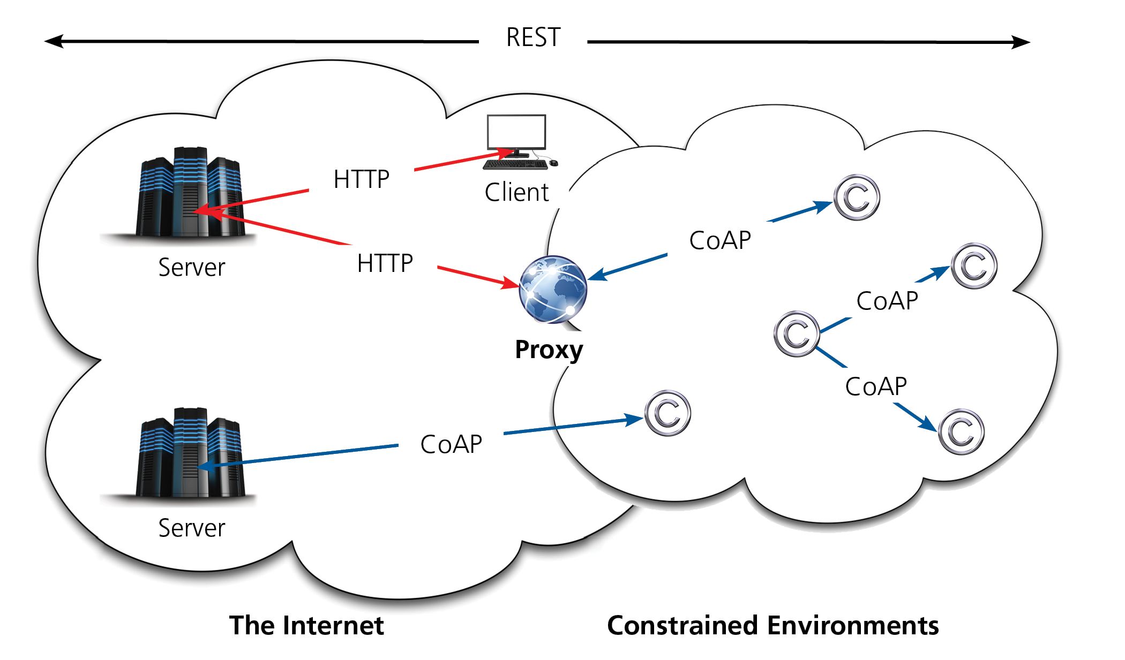
Data handling in CoAP- Constrained Application Protocol
MQTT messages can be used for any purpose, but all clients must know the message formats up-front to allow communication.
CoAP, conversely, provides inbuilt support for content negotiation and discovery allowing devices to probe each other to find ways of exchanging data.
The CoAP protocol is very similar to HTTP and includes several HTTP functionalities, but has been redesigned (and not simply compressed) to account for these devices’ constraints

Slide 5
IoT Rule Engine
Rules engines are the software tools that are used to build and run business logic
Kafka Streams : Library for building real time applications
Data input and output are stored in Apache Kafka clusters
Kafka is used for transforming measurement of physical parameters and publishing them.
Data has to be stored in a scalable and fault-tolerant database
NoSQL Databases are used for this scenario

Slide 6
Data storage: NoSQL
Why avoid SQL?
Because Joins are expensive
Hard to scale horizontally
Not fast enough
NoSQL
Tuple contains a name, value & timestamp
Collections with values
Faster handling of large data

Slide 7
Handling topics using Kafka
A topic is a queue of messages written by one or more producers and read by one or more consumers.
A topic is identified by its name.
Publisher -> Producer in Kafka
Subscriber -> Consumer in Kafka

Slide 8
Apache Kafka
Kafka is a distributed system that implements the basic features of the ideal publish-subscribe system.
Each host in the Kafka cluster runs a server called a broker that stores messages sent to the topics and serves consumer requests.
Kafka brokers all talk to Zookeeper for distributed coordination
Kafka is designed to run on multiple hosts, with one broker per host. If a host goes offline, Kafka does its best to ensure that the other hosts continue running.

Slide 9
Apache Kafka
No Downtime” and “Unlimited Scaling” goals from the ideal publish-subscribe system
Topics are replicated across brokers
Having a single queue has scaling issues. Kafka implements partitions for adding robustness to topics.

Slide 10
Apache Kafka
Key difference with Ideal system are:
Messaging is implemented on top of a replicated, distributed commit log.
The client has more functionality and, therefore, more responsibility.
Messaging is optimized for batches instead of individual messages.
Messages are retained even after they are consumed; they can be consumed again.
The results of these design decisions are:
Extreme horizontal scalability
Very high throughput
High availability
but, different semantics and message delivery guarantees

Slide 11
Partitioning in Kafka
Instead of all records handled by the system being stored in a single log, Kafka divides records into partitions.
Partitions can be thought of as a subset of all the records for a topic. Partitions help with the ideal of “Unlimited Scaling”.

Slide 12
Partitioning in Kafka
Any Kafka client (a producer or consumer) communicates only with the leader partition for data. All other partitions exist for redundancy and failover.
Follower partitions are responsible for copying new records from their leader partitions.
Ideally, the follower partitions have an exact copy of the contents of the leader. Such partitions are called in-sync replicas (ISR).

Slide 13
Apache Cassandra
Decentralized NoSQL DB
High scalability & availability
Organized as ring of nodes. Node takes care of portion of data
Client should allocate measures across Cassandra nodes

Slide 14
Apache Cassandra
Node B takes care of hash data range 51214-60012.
Node A takes care of 32768-40917
Cassandra based on SSTable
Writing is asynch
Invalidates data rather than delete.

Slide 15
Kairos DB
Time series DB on top of Cassandra
Flexible API to build plugins
KairosDB plugins can consume data directly from Kafka
Combination fo Kafka – Karios on Cassandra is ideal

Slide 16
Additional slides

